Slide 1
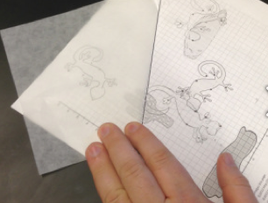
Transformational Perspective to Geometry
Travis Lemon
lemonmath@gmail.com
@TravisLemon
@MVPmath
Mathematics Vision Project
NCSM San Diego 2019
http://bit.ly/MVPpresentations

Slide 2
What is your experience approaching Geometry from a transformational perspective? What’s does it mean to approach Geometry from a transformational perspective? A progression that embraces this approach.

Slide 3
Open Educational Resources (OER)
Task-based materials for Integrated courses and AGA
Connected to all the practices
Mathematicsvisionproject.org
Partnering with Open Up Resources

Slide 5
MVP courses this summer!
Teach Like an MVP
Algebra and Functions
Access & Equity
San Diego
Monterey County
Salt Lake City

Slide 6
What is your experience approaching Geometry from a transformational perspective? What’s does it mean to approach Geometry from a transformational perspective? A progression that embraces this approach.

Slide 7
There is a difference between doing transformations and approaching geometry from a transformational perspective!
Notes:
.

Slide 8
Do you and your teachers engage students in a transformational approach?
Can your students use transformations as a tool for thinking and reasoning while creating proofs?
Do your students even attempt to think with and use transformations while creating proofs?
Do you know what this would look like?
Notes:
.

Slide 9
Using Transformations to Set the Stage for Proof
“…work with transformations can help strengthen students’ understanding of proof. To prove congruence students can use a transformation to map one figure onto another, since two figures are congruent if and only if a transformation can be found that maps one figure onto the other.”
Putting Essential Understanding of Geometry into Practice 9-12, NCTM 2015, p. 86
Notes:
.

Slide 10
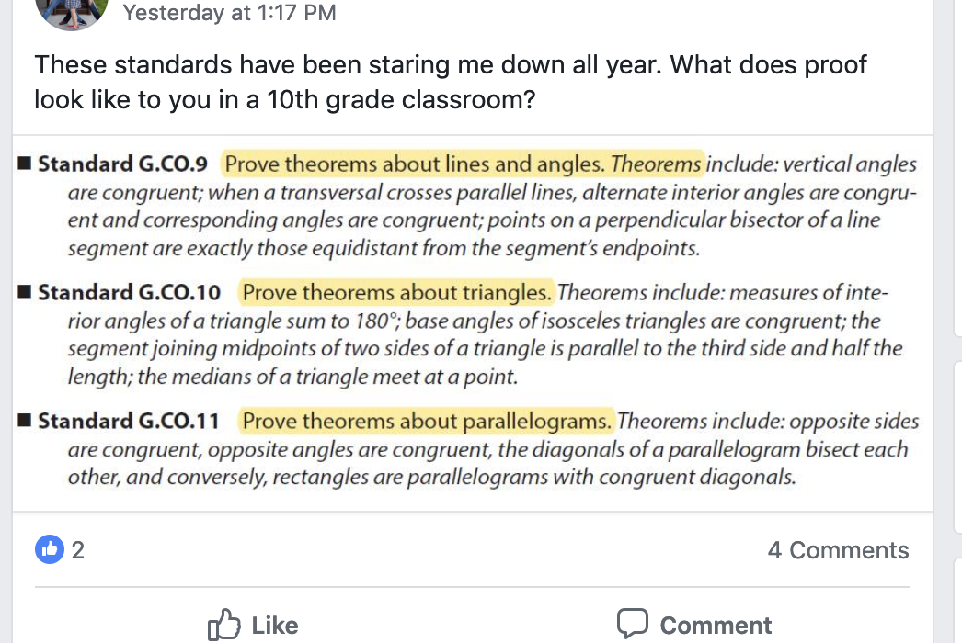
Do you and your teachers feel like this?
Notes:
.

Slide 11
How do you approach or build geometry? What is the “intuition” you start with?
Answer 1: Create an axiomatic system with undefined terms and accepted postulates. Build your system of Geometry showing that it works because you can prove it.
Answer 2: Start in the same way Euclid did: construct everything. Geometry work because we can construct it.
Answer 3: Base everything on the notion of transformations in the coordinate plane. Geometry works because I can draw shapes and move them around.
http://mathymcmatherson.wordpress.com/2011/08/19/intuition-in-geometry-the-common-core-standards/

Slide 12
Using Transformations to Set the Stage for Proof
“The intuitive notion of congruence gets lost within the abstract axiomatic system and becomes reduced to a collection of memorized rules. As a result, the development of congruence lacks coherence between middle and high school, which may hinder student understanding.”
Wiles, Lemon, King, May 2019, MTMS vol. 24, issue 7, pg. 416
Notes:
s

Slide 13
Using Transformations to Set the Stage for Proof
“When viewed through a transformational lens, however, the intuitive perspective leads seamlessly into a more formal treatment. Informally, congruence can be established through the idea of superposition. In other words, two shapes are congruent if one shape can fit exactly on top of the other.”
Wiles, Lemon, King. May 2019, MTMS vol. 24, issue 7, pg. 416
Notes:
.

Slide 14
Engaging in proof
Did any of you attempt to use transformations as you worked on the proofs that you picked up when you came in?
Lets look at some work from students.
What do you notice?
How do students seem to approach the work?

Slide 15
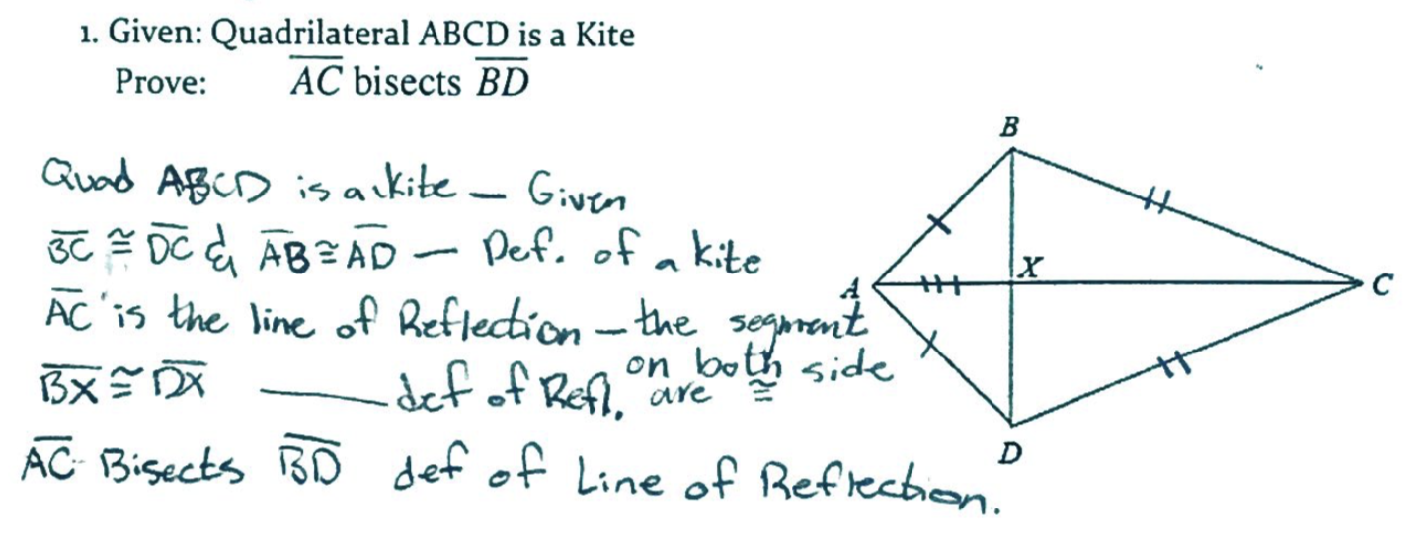
Student seeking to prove using transformations

Slide 16
Student seeking to prove using transformations

Slide 17
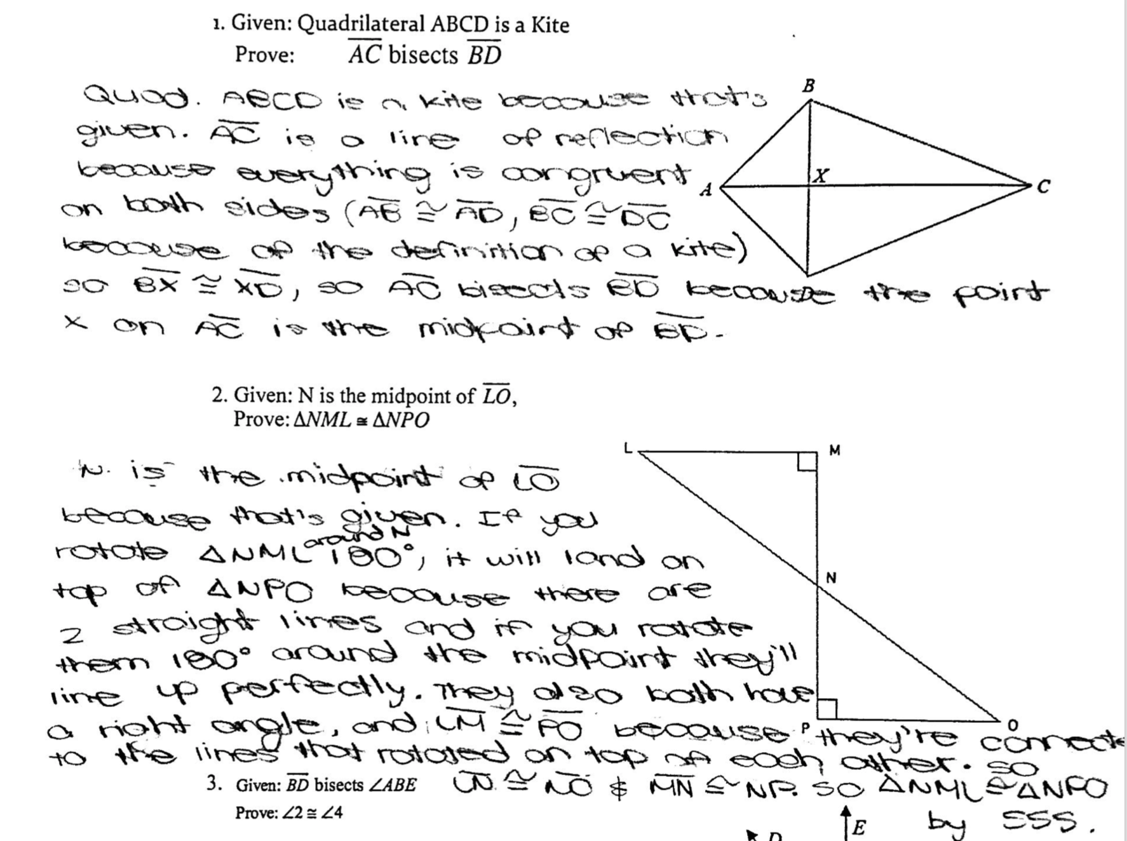
Student seeking to prove using transformations

Slide 18
Student seeking to prove using transformations

Slide 19
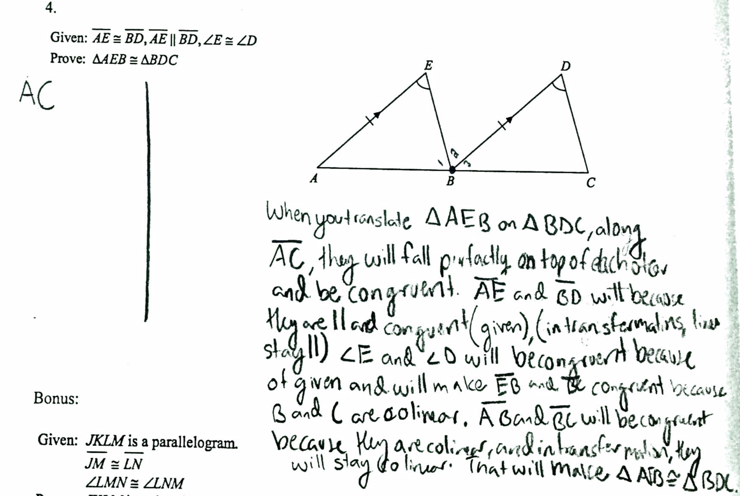
Student seeking to prove using transformations

Slide 20
Student seeking to prove using transformations

Slide 21
Engaging in proof
What led to this student work?
What learning experiences were provided to cultivate the use of transformations as a tool when proving?

Slide 22
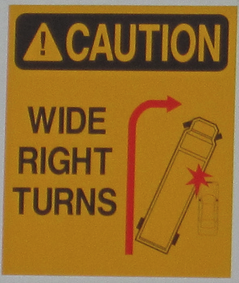
Learning Cycle: meaningful development over time
Develop
Solidify
Practice
Leaping Lizards
Leap Year
Leap Frog
Is It Right?

Slide 23
Leaping Lizards A Develop Understanding Task
Mathematics Vision Project
Math 1 Module 6
Geometry Module 1
mathematicsvisionproject.org
See further discussion (Wiles, Lemon, King coming in May 2019 Mathematics Teaching in the Middle School. Vol. 20, Issue 7.)

Slide 24
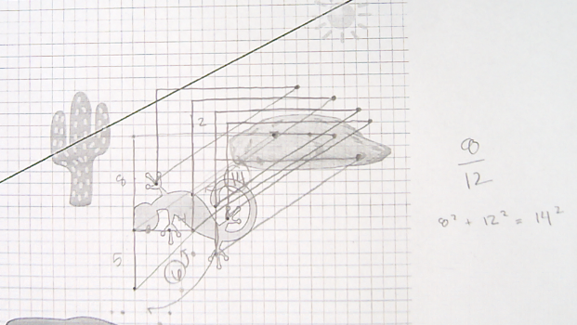
Students developing definitions of transformations and an understanding of their underlying structure

Slide 25
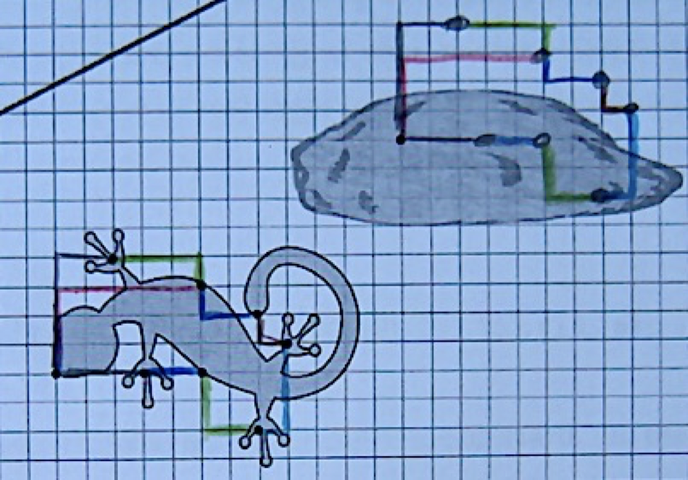
Students developing definitions of transformations and an understanding of their underlying structure

Slide 26
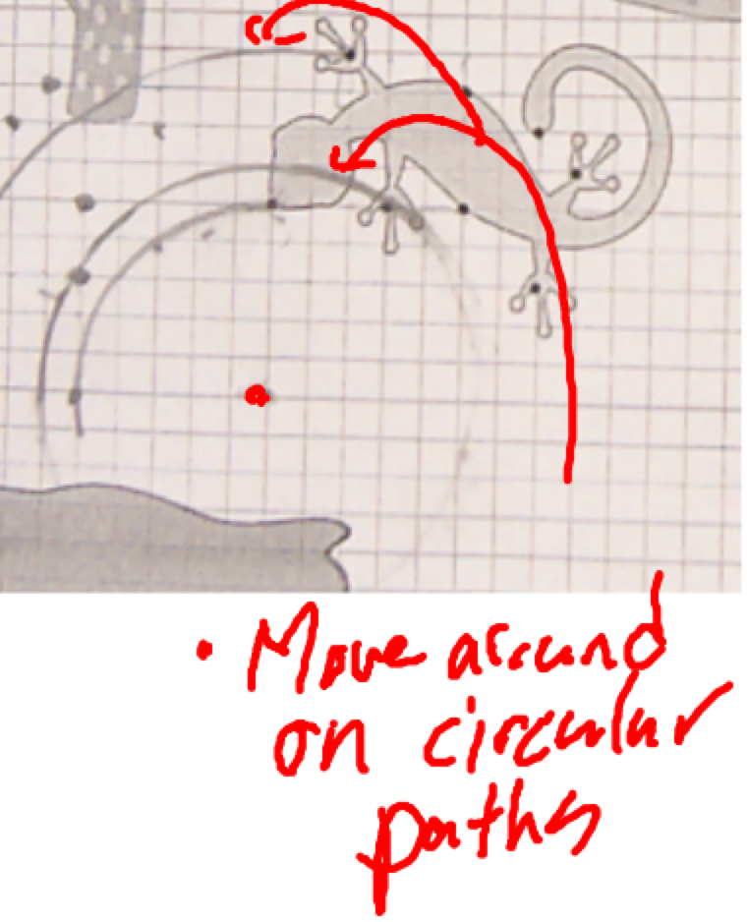
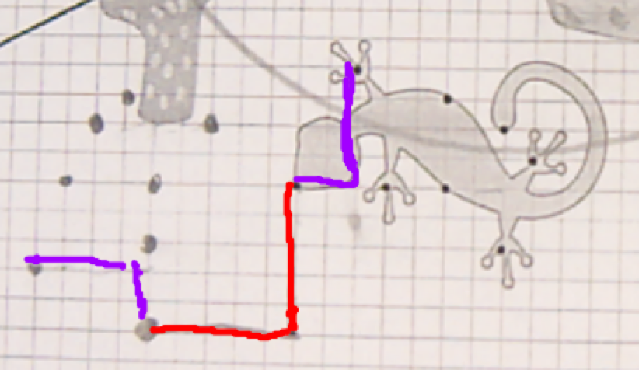
Students developing definitions of transformations and an understanding of their underlying structure

Slide 27
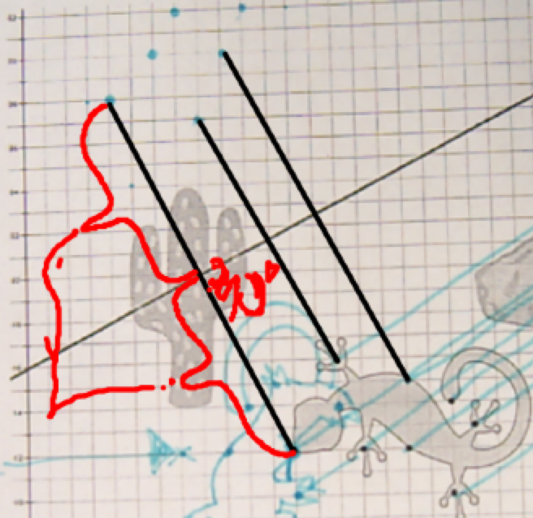
Students developing definitions of transformations and an understanding of their underlying structure

Slide 28
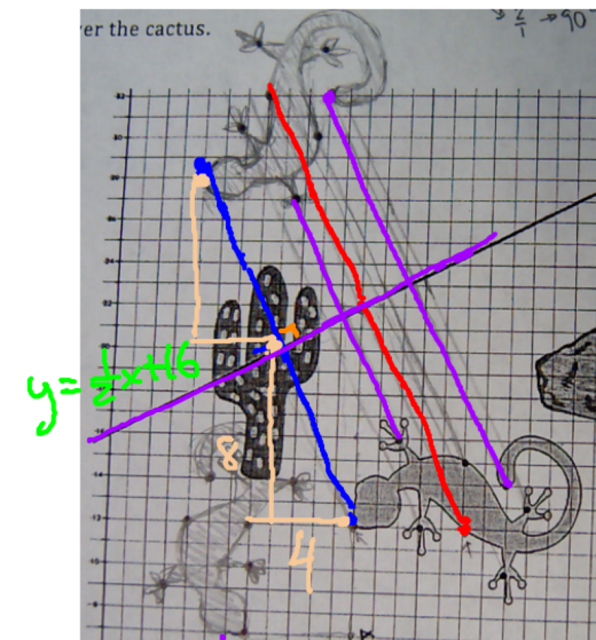
Students developing definitions of transformations and an understanding of their underlying structure

Slide 29
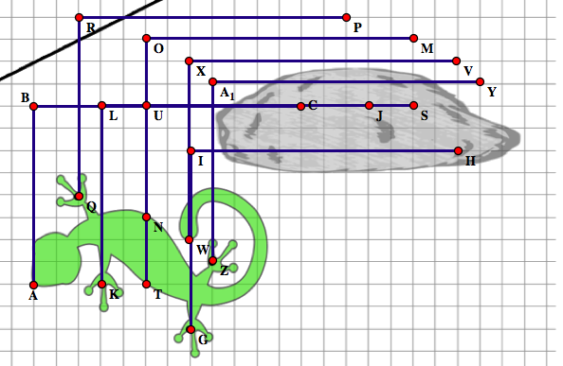
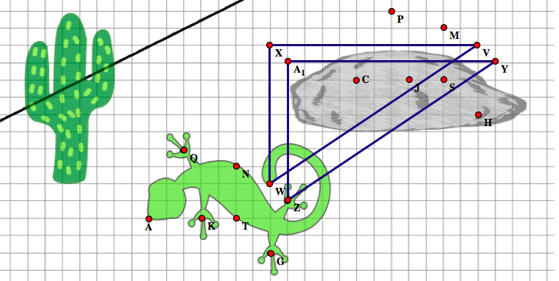
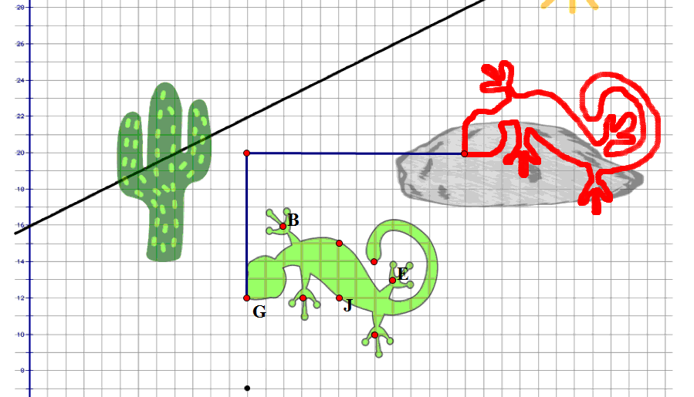
Definitions of rigid motion transformations as a foundation for proof
Are our descriptions or definitions of these transformations sufficient for the work we need to do?
Notes:
For the work we are going to do in Math I geometry, we need definitions of the rigid motion transformations that are precise enough to tell us how to locate points in the transformed image. Let’s examine some student work to see how it might inform our definitions.
Take a minute to examine this work produced by some students who are carrying out the instruction to “translate the lizard so that the tip of its nose, originally located at the point (12, 12), is moved to the point (24, 20). As you examine this work, consider what it tells us about defining features of a translation. I’ll give you a couple of minutes of private reflection or time to turn and talk to someone else at your site.
[Continue after a couple of minutes] Two strategies emerge for locating points on the translated lizard as students work on this task. One strategy, as illustrated in the first diagram, is to determine how far up and to the right the tip of the nose has been moved, and then move all of the other points the same distance up and over.
[Draw the following strategy on the screen image #3 as it is described] A second strategy that emerges is to use the idea that a translation preserves distance and angle measure, so whatever distance and direction we move to get from one point to another in the original image, we can move the same distance and direction between corresponding points in the transformed image. For example, since the center of the left foot of the lizard is 3 units to the right of the tip of the nose in the original image, it must also be three units from the tip of the nose in the transformed image. Students using this strategy are attending to the idea that a translation preserves distance and angle measurement. One of the interesting ideas that surfaces from this strategy is that line segments connecting two points in the original image are parallel to the corresponding line segment in the transformed image. For those of you who will be teaching the MVP Secondary Math II task Parallelism Preserved and Protected, this idea becomes known as the “parallel postulate for translations.”
The middle diagram shows an important defining feature of translations, that “points move the same distance along parallel lines.”

Slide 30
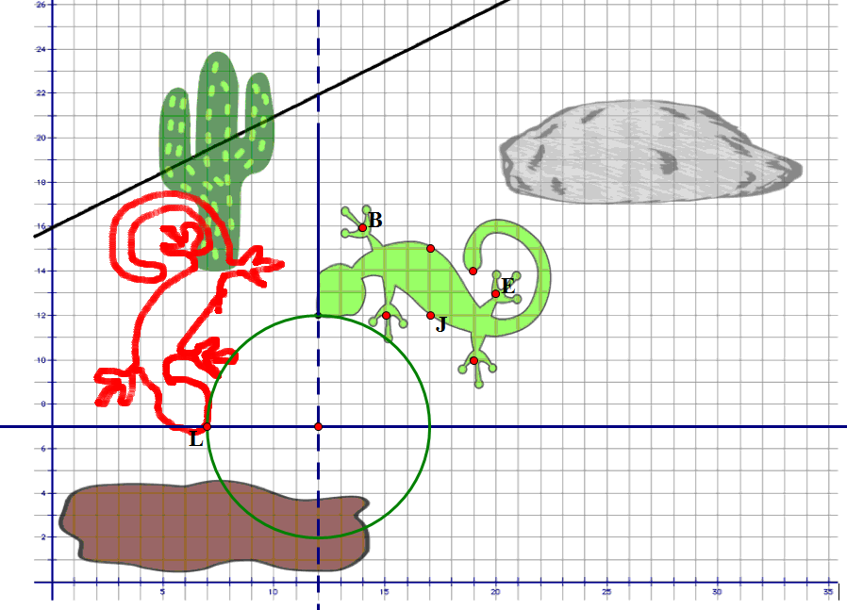
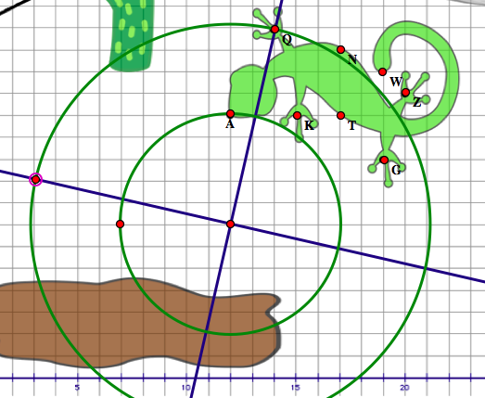
Definitions of rigid motion transformations as a foundation for proof
Are our descriptions or definitions of these transformations sufficient for the work we need to do?
Notes:
In the second part of the task students were instructed to rotate the lizard 90 degrees counterclockwise about a point that was not located on the lizard. Research shows that this is a difficult concept for students to grasp. They are much more successful at visualizing rotation about a point on the object, such as rotating the lizard about the tip of its nose. Take a minute to examine these figures to see if you can describe the defining features of a rotation.
Obviously, one important feature of a rotation is the center of rotation. Just as points move the same distance along parallel lines in a translation, points move the same angle of rotation around concentric circles in a rotation. Since points move around circular paths, this means that a point on the original lizard and the corresponding point on the rotated lizard are the same distance from the center of rotation—a second important defining feature of a rotation. Finally, angles formed by line segments connecting the center to corresponding pre-image and final-image points must measure the same angle, in this case 90 degrees.
By the way, in this task, because the work takes place on a coordinate grid, students begin to surface some ideas about conditions that create perpendicular line segments, simply by counting the spaces “up and over” from the center of rotation to a point on the original lizard, and then counting “back and up” to get a corresponding point on the rotated lizard, essentially noticing the use of the opposite reciprocal slope to produce a right angle. This emerging idea is solidified in the next task in the MVP curriculum, Is It Right?

Slide 31
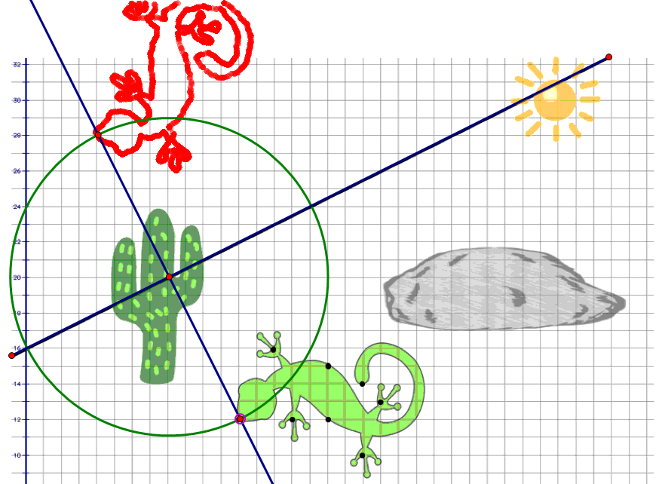
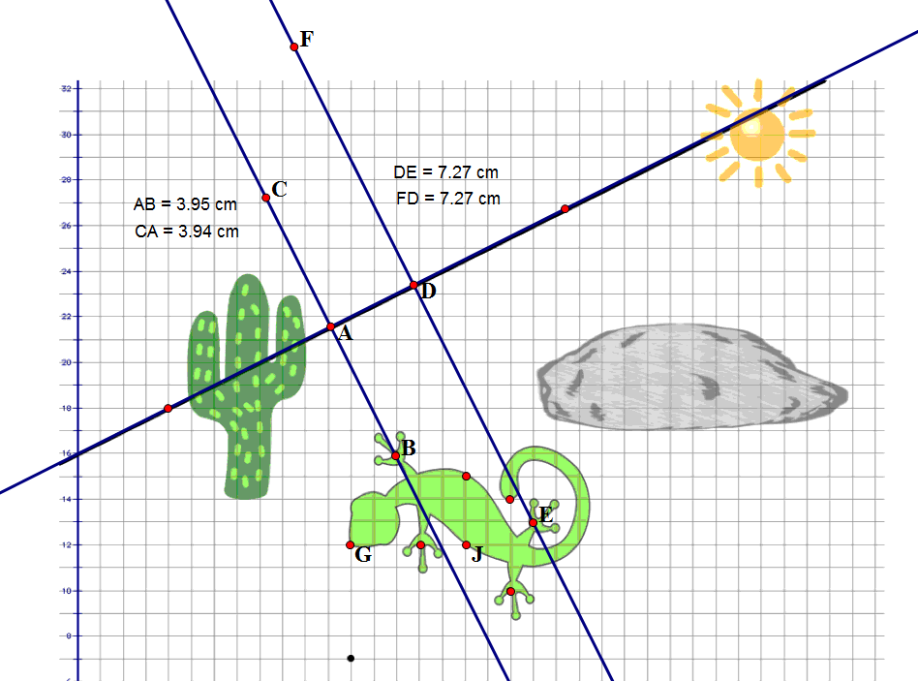
Definitions of rigid motion transformations as a foundation for proof
Are our descriptions or definitions of these transformations sufficient for the work we need to do?
Notes:
In the last part of Leaping Lizards students are asked to reflect the lizard about a given line. The diagram on the right suggests the strategy that most of us might use—that is, drawing lines perpendicular to the reflecting line and then measuring equal distances from the reflecting line to points on the original lizard and corresponding points on the reflected lizard. However, it has been surprising to us to see students use a strategy that involves using circles as a “tool” for making sure that the distance from the mirror to corresponding image and pre-image points are equal, such as in the first diagram.
[Illustrate the following on the screen] What is even more surprising is that students use this circle, whose center is on the reflecting line, to conjecture that any point where the circle intersects the lizard has a corresponding point on the reflected lizard that lies on the same circle in such a way that the radii connecting the center of the circle to the pre-image and image points form congruent angles with the reflecting line. [Illustrate this with the point where the circle intersects the back of the lizard]
That is, using perpendicular angles to the reflecting line that we generally think of in reflections are just a special case of a more general idea: the corresponding image and pre-image points lie the same distance from any point on the reflecting line along rays that form congruent angles on either side of the reflecting line. Later, students will observe that this is a property of a perpendicular bisector. I have to admit that even though I was the author of this task, I have expanded my thinking by observing students engaging in this task. This illustrates the power of providing students with tasks that promote reasoning and problem solving and allowing them to engage in the work as emerging mathematicians.

Slide 32
Using Transformations to Set the Stage for Proof
“For students to approach geometry in a truly transformational manner, they will need to have opportunities to explore the transformations in ways that emphasize their relationships, underlying structures, and invariant properties.”
“When students understand the structure and geometric attributes related to transformations, they are better equipped to engage in proof using transformations as a foundation.”
Wiles, Lemon, King. May 2019, MTMS vol. 24, issue 7, pg. 420
Notes:
.

Slide 33
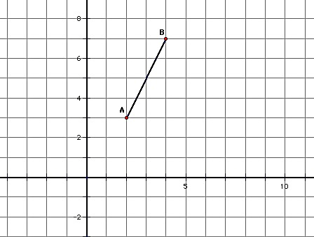
Is It Right? A Solidify Understanding Task
Experiment 1
Consider the points A (2, 3) and B (4, 7) and the
line segment between them. What is the slope of this line segment?
Locate a third point C (x, y) on the coordinate grid, so the points A (2, 3), B (4, 7) and C (x, y) form the vertices of a right triangle, with AB as its hypotenuse.
Explain how you know that the triangle you formed contains a right angle?
Now rotate this right triangle 90° about the vertex point (2, 3). Explain how you know that you have rotated the triangle 90°.
Compare the slope of the hypotenuse of this rotated right triangle with the slope of the hypotenuse of the pre-image. What do you notice?

Slide 34
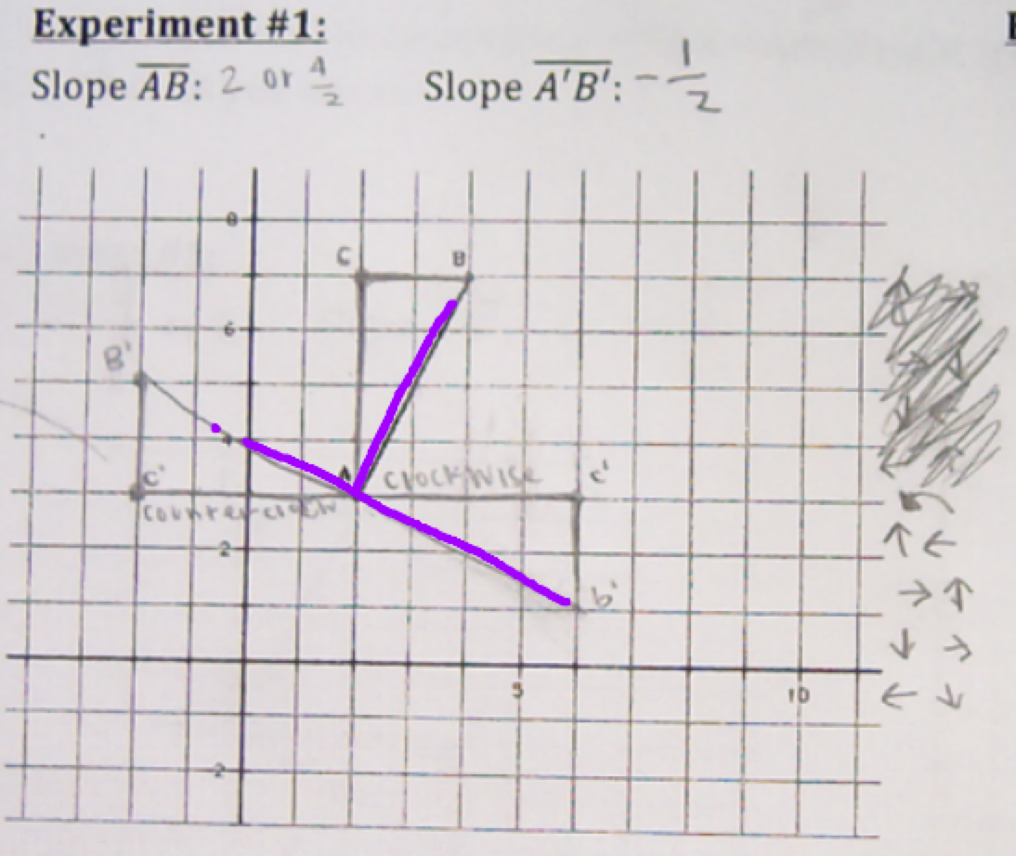
Is It Right? A Solidify Understanding Task
Experiment 1
Consider the points A (2, 3) and B (4, 7) and the
line segment between them. What is the slope of this line segment?
Locate a third point C (x, y) on the coordinate grid, so the points A (2, 3), B (4, 7) and C (x, y) form the vertices of a right triangle, with AB as its hypotenuse.
Explain how you know that the triangle you formed contains a right angle?
Now rotate this right triangle 90° about the vertex point (2, 3). Explain how you know that you have rotated the triangle 90°.
Compare the slope of the hypotenuse of this rotated right triangle with the slope of the hypotenuse of the pre-image. What do you notice?

Slide 35
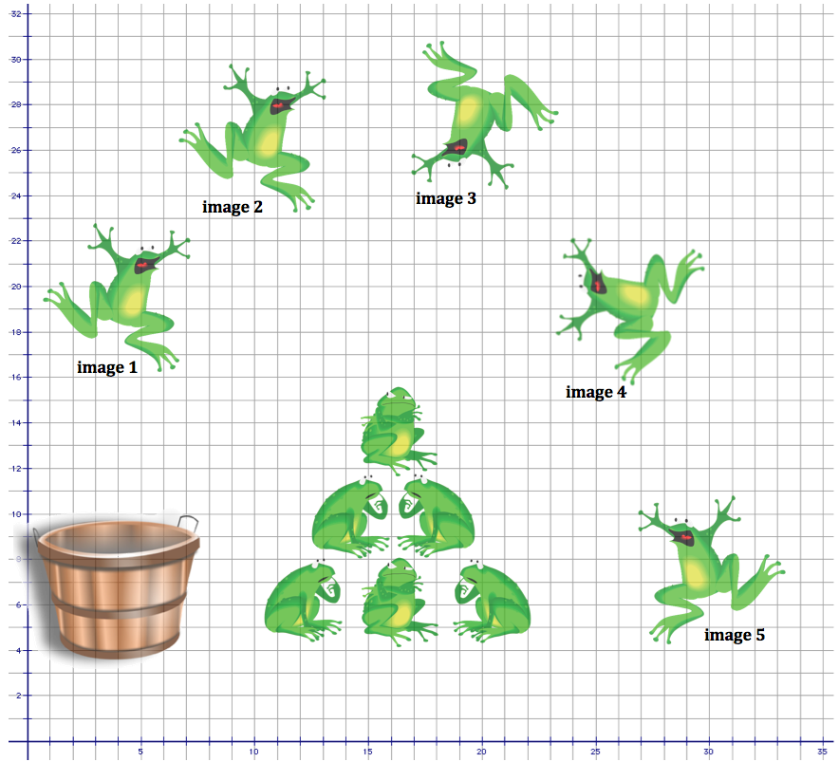
Leap Frog A Solidify Understanding Task
For each pre-image/image combination listed below, describe the transformation or transformations that moves the pre-image to the final image.
Image 1 to image 2
Image 2 to image 3
Image 3 to image 4
Image 1 to image 5

Slide 36
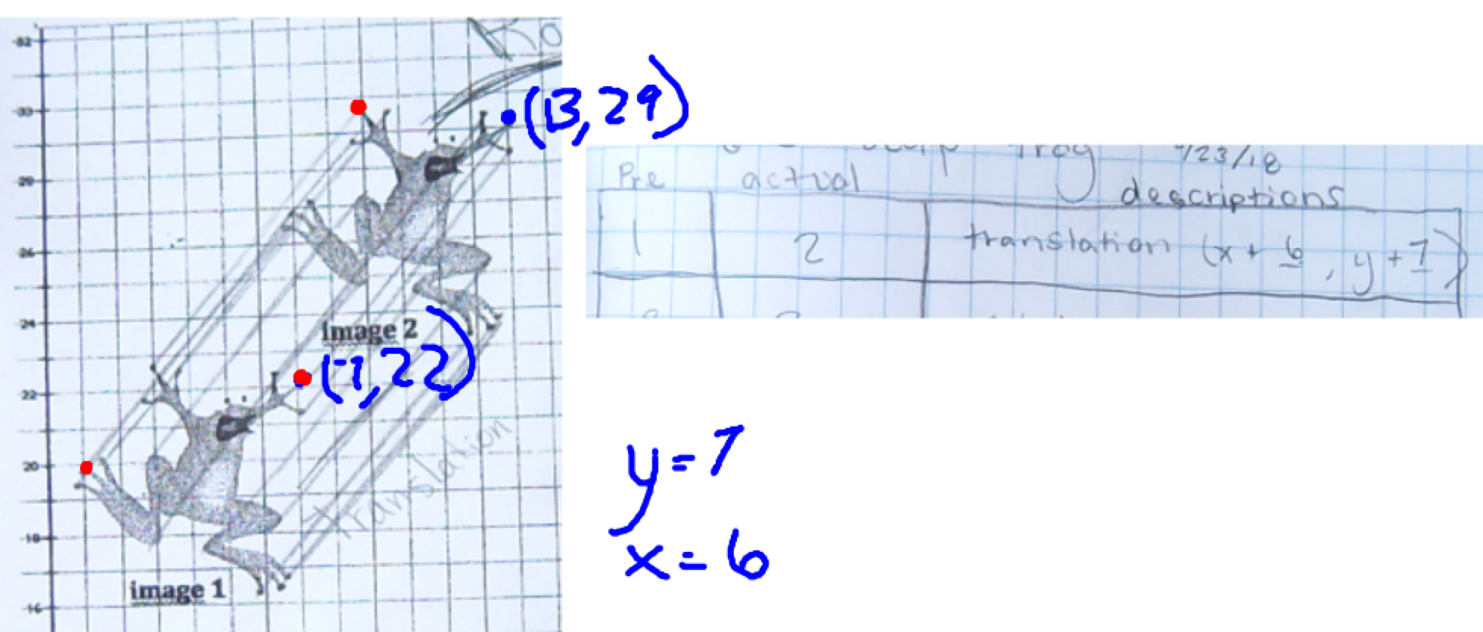
Leap Frog A Solidify Understanding Task
For each pre-image/image combination listed below, describe the transformation or transformations that moves the pre-image to the final image.
Image 1 to image 2
Image 2 to image 3
Image 3 to image 4
Image 1 to image 5

Slide 37
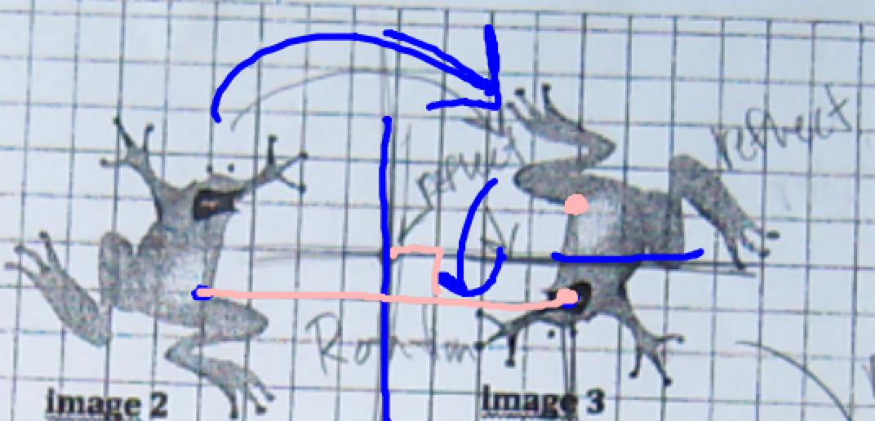
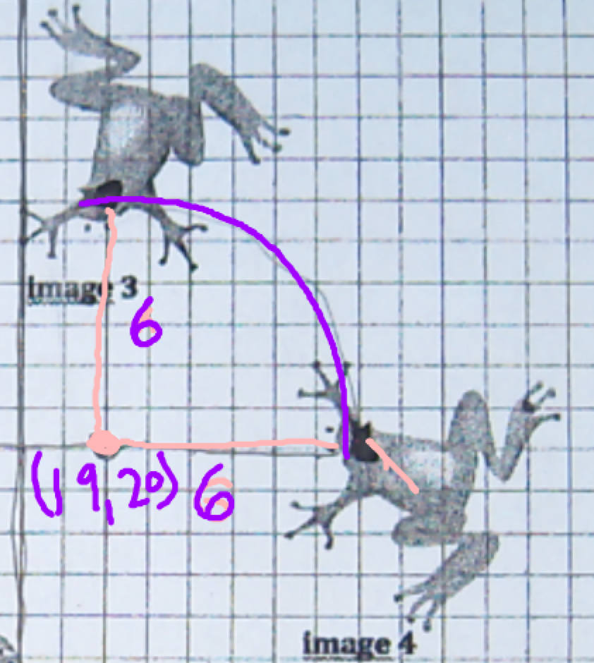
Leap Frog A Solidify Understanding Task
For each pre-image/image combination listed below, describe the transformation or transformations that moves the pre-image to the final image.
Image 1 to image 2
Image 2 to image 3
Image 3 to image 4
Image 1 to image 5

Slide 38
Leap Year A Practice Understanding Task
How would you complete each of the following definitions?
1. A translation of a set of points in a plane . . .
2. A rotation of a set of points in a plane . . .
3. A reflection of a set of points in a plane . . .

Slide 39
Using Transformations to Set the Stage for Proof
“Students may have the idea that definitions are strings of words that a textbook supplies and they are supposed to transcribe in their notes. This notation does not promote the development of geometric thinking. At a very basic level, students must understand that many definitions for the same concept or shape are valid, that definitions are evaluated by a community, …, perhaps most important that they themselves can and should create definitions.”
Putting Essential Understanding of Geometry into Practice 9-12, NCTM 2015, p. 86
Notes:
.

Slide 40
Learning Cycle: meaningful development over time
Develop
Solidify
Practice
Leaping Lizards
Leap Year
Leap Frog
Is It Right?

Slide 41
CCSSM geometry progressions from a learning cycle perspective: Properties of Transformations
Develop
Solidify
Practice
8.G.1. Verify experimentally the properties of rotations, reflections, and translations:
Lines are taken to lines, and line segments to line segments of the same length.
Angles are taken to angles of the same measure.
Parallel lines are taken to parallel lines.
G.CO.4. Develop definitions of rotations, reflections, and translations in terms of angles, circles, perpendicular lines, parallel lines, and line segments.
(a Secondary Math I standard)
G.CO.5. Given a geometric figure and a rotation, reflection, or translation, draw the transformed figure using, e.g., graph paper, tracing paper, or geometry software.
G.CO.6. Use geometric descriptions of rigid motions to transform figures and to predict the effect of a given rigid motion on a given figure
(Secondary Math I standards)
8.G.2. Describe the effect of dilations, translations, rotations, and reflections on two-dimensional figures using coordinates.
G.CO.2. Represent transformations in the plane using, e.g., transparencies and geometry software; describe transformations as functions that take points in the plane as inputs and give other points as outputs
(a Secondary Math I standard)

Slide 42
Symmetries of Quadrilaterals
“Symmetry can be defined by using transformations. Students are often familiar with symmetry formed by reflection, such as the symmetry in butterfly cutouts or snowflakes. But there are other symmetries as well… In all these cases, basic properties of the figures can be seen as consequences of their symmetry.”
Catalyzing Change in High School Mathematics, NCTM 2018, p. 71

Slide 43
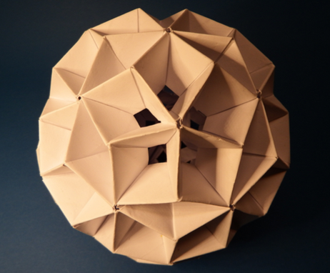
Symmetries of Quadrilaterals A Develop Understanding Task
Focus questions:
What convinces you that the quadrilateral in question possesses the types of symmetry you claimed?
How are you relying upon our definitions of the rigid motion transformations to support your claims?
Where does our work fit on the “Ways of Knowing” Continuum?

Slide 44
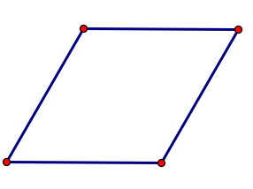
Symmetry as a foundation for proof
What centers of rotation or lines of reflection will carry a rhombus onto itself?

Slide 45
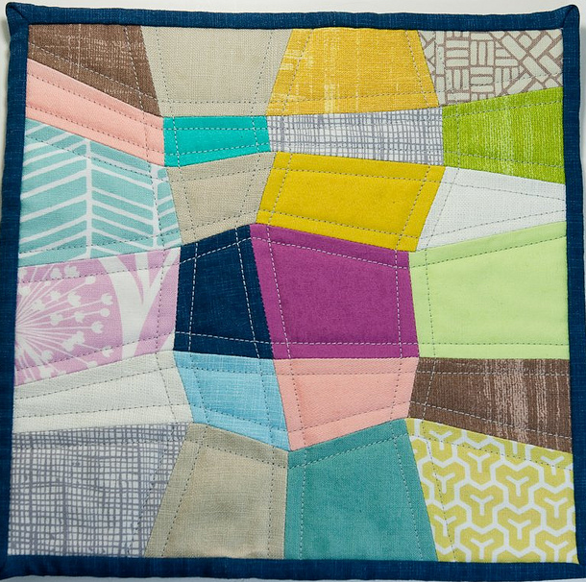
Quadrilaterals—Beyond Definition A Practice Understanding Task
180° rotation
In the chart, what quadrilaterals are being described in terms of their symmetries?
What do you notice about the relationships between quadrilaterals based on their symmetries and highlighted in the structure of the chart?
180° rotation
2 lines of symmetry
(diagonals)
180° rotation
2 lines of symmetry
(through midpoint of sides)
90° and 180° rotation
4 lines of symmetry
(diagonals & through midpoint of sides)

Slide 46
Quadrilaterals—Beyond Definition A Practice Understanding Task
2 pairs of parallel sides
In this chart, what quadrilaterals are being described in terms of their features and properties?
Record any additional features or properties of that type of quadrilateral you may have observed. Be prepared to share reasons for your observations.
2 pairs of parallel sides
all four sides are congruent
2 pairs of parallel sides
all four angles are congruent
2 pairs of parallel sides
all four sides are congruent
all four angles are congruent

Slide 47
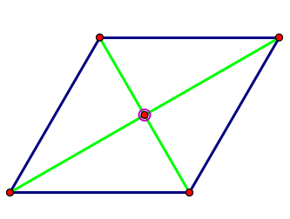
Symmetry as a foundation for proof
Based on your experimentation with rigid motions that carry a rhombus onto itself, what might you conjecture about the characteristic properties of a rhombus, in addition to the defining characteristic that all four sides are congruent?

Slide 48
Symmetry as a foundation for proof
Based on your experimentation with rigid motions that carry a rhombus onto itself, what might you conjecture about the characteristic properties of a rhombus, in addition to the defining characteristic that all four sides are congruent?
Opposite angles are congruent
The diagonals bisect each other
The diagonals bisect the angles
The diagonals are perpendicular to each other

Slide 50
Constructions as a foundation for proof
Using the given segment and angle, construct a rhombus

Slide 51
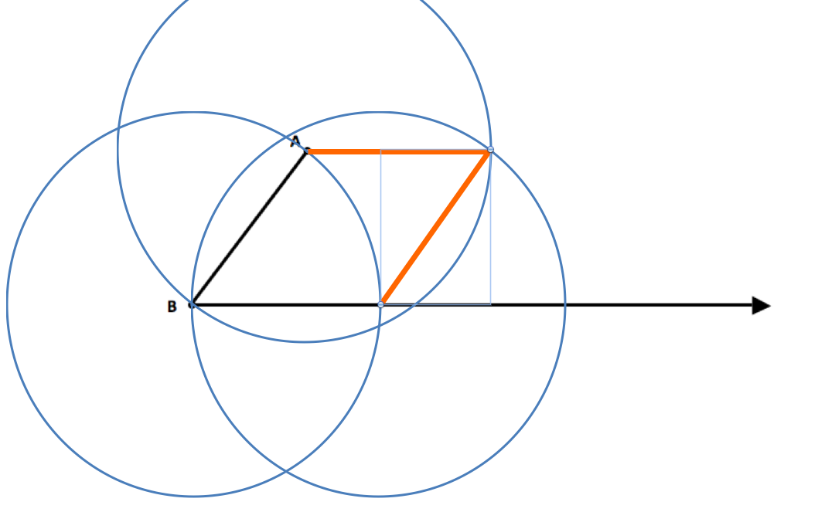
Constructions as a foundation for proof

Slide 52
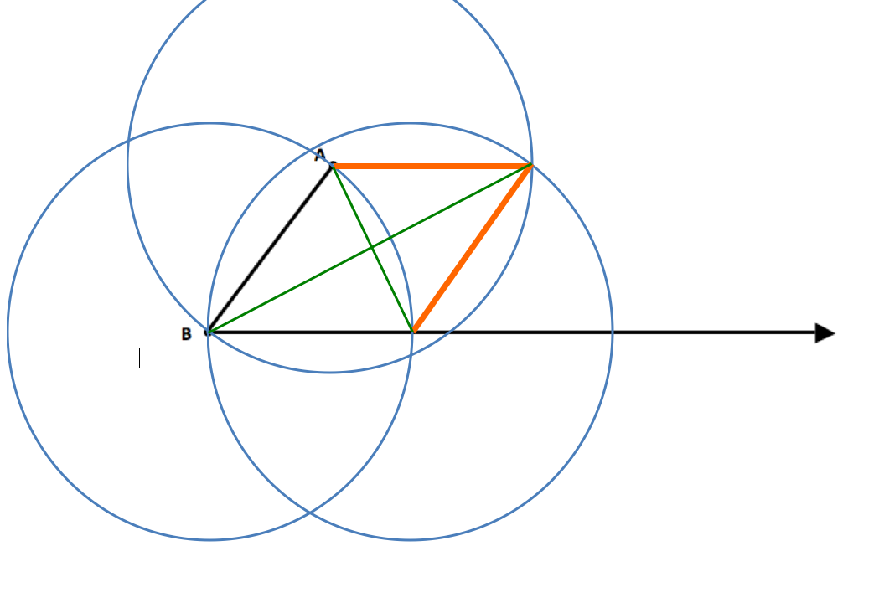
Constructions as a foundation for proof

Slide 53
CCSSM geometry progressions from a learning cycle perspective: Triangle Congruence Criteria
Develop
Solidify
Practice
7.G.2. Draw (freehand, with ruler and protractor, and with technology) geometric shapes with given conditions. Focus on constructing triangles from three measures of angles or sides, noticing when the conditions determine a unique triangle, more than one triangle, or no triangle.
8.G.2. Understand that a two-dimensional figure is congruent to another if the second can be obtained from the first by a sequence of rotations, reflections, and translations; given two congruent figures, describe a sequence that exhibits the congruence between them.

Slide 54
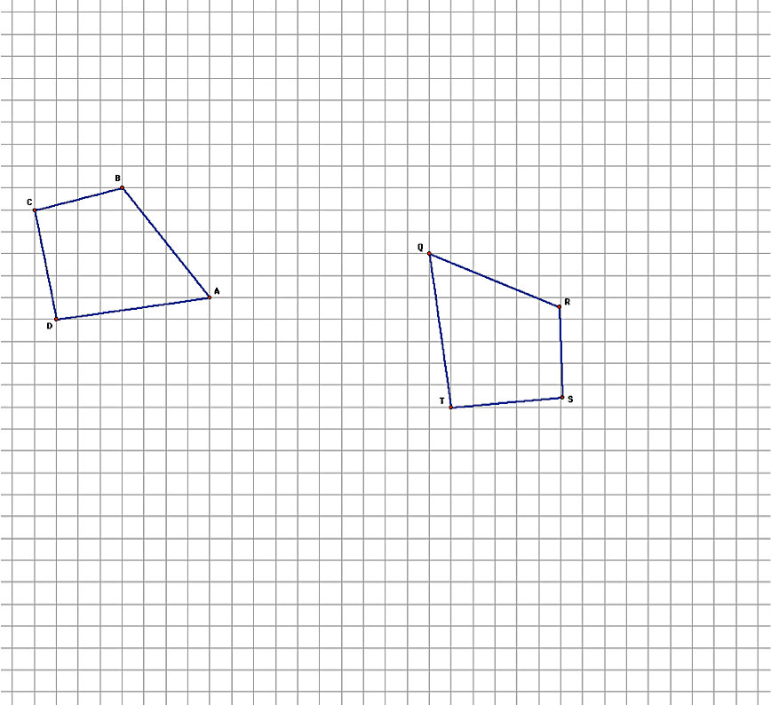
Can You Get There From Here? A Develop Understanding Task
What does it mean to say that two geometric figures are congruent?
Describe a sequence of rigid-motion transformations that will carry quadrilateral ABCD onto quadrilateral QRST.
Is there a sequence that that is logically efficient?

Slide 55
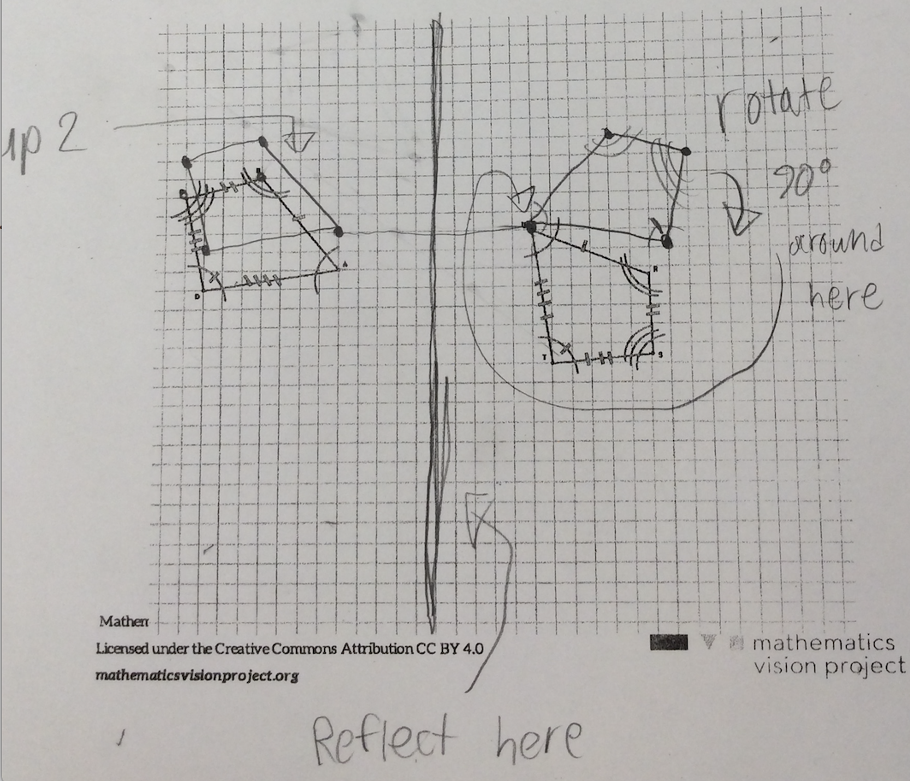
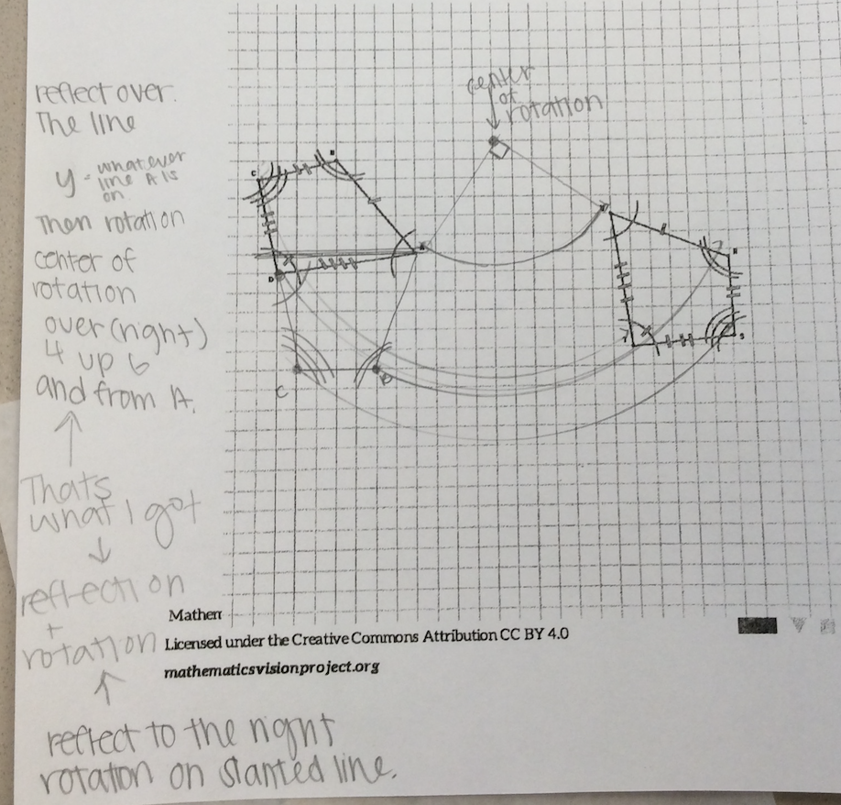
Can You Get There From Here? A Develop Understanding Task

Slide 56
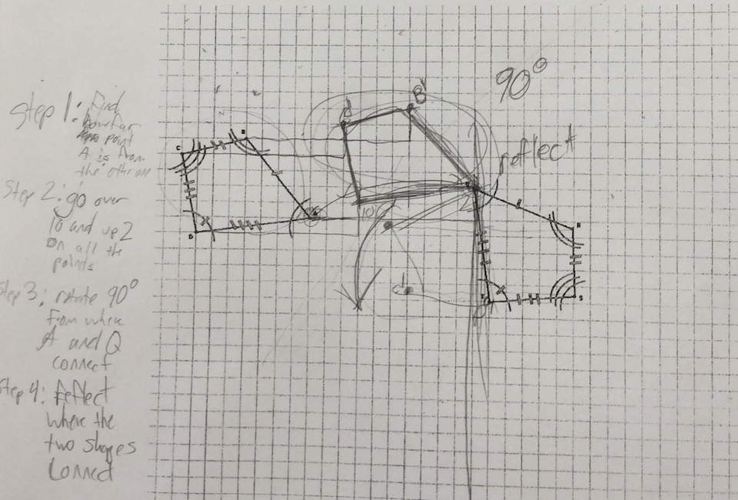
Can You Get There From Here? A Develop Understanding Task

Slide 57
Can You Get There From Here? A Develop Understanding Task

Slide 58
Can You Get There From Here? A Develop Understanding Task
Logical efficiency when working with transformations
Translate, Rotate, Reflect

Slide 59
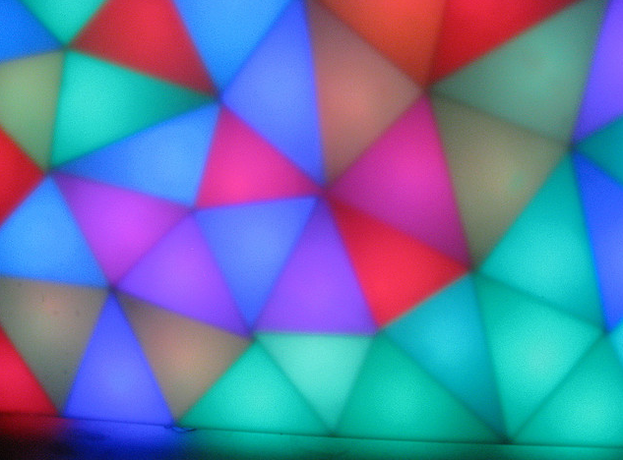
Congruent Triangles A Solidify Understanding Task
Based on the diagram, which angles are congruent? Which sides?
To convince ourselves that these two triangles are congruent, what else would we need to know?
Use tracing paper to find a sequence of transformations that will show whether or not these two triangles are congruent.
List your sequence of transformations here:

Slide 60
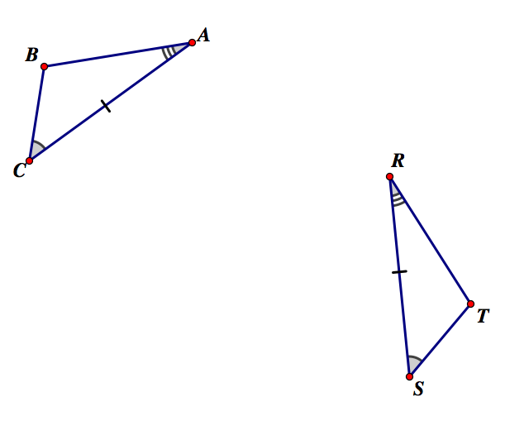
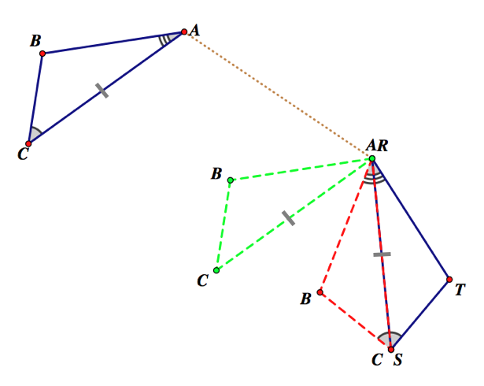
Justification of ASA triangle congruence based on rigid motion transformations
Prove that the two triangles are congruent given that the ASA corresponding parts are congruent as marked.
Transformational proof:

Slide 61
CCSSM geometry progressions from a learning cycle perspective: Triangle Congruence Criteria
Develop
Solidify
Practice
G.CO.8. Explain how the criteria for triangle congruence (ASA, SAS, and SSS) follow from the definition of congruence in terms of rigid motions.
(a Secondary Math I standard)
7.G.2. Draw (freehand, with ruler and protractor, and with technology) geometric shapes with given conditions. Focus on constructing triangles from three measures of angles or sides, noticing when the conditions determine a unique triangle, more than one triangle, or no triangle.
G.CO.7. Use the definition of congruence in terms of rigid motions to show that two triangles are congruent if and only if corresponding pairs of sides and corresponding pairs of angles are congruent.
(a Secondary Math I standard)
8.G.2. Understand that a two-dimensional figure is congruent to another if the second can be obtained from the first by a sequence of rotations, reflections, and translations; given two congruent figures, describe a sequence that exhibits the congruence between them.

Slide 62
Using Transformations to Set the Stage for Proof
“One of your goals in teaching proof should be to expand your students’ notion of proof to include an understanding of it as a multifaceted tool for investigation and communication, as well as the verification of results. Understanding the nature of proof involves knowing that proof is not separate from learning and doing mathematics but is an integral part of mathematics at all levels and phases.
Putting Essential Understanding of Geometry into Practice 9-12, NCTM 2015, p. 116
Notes:
.

Slide 63
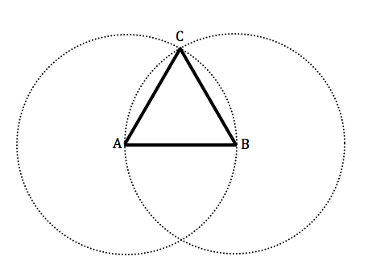
Do You See What I See? A Develop Understanding Task
Sometimes we are asked to draw a conclusion from a diagram when we are given the last diagram in a sequence steps. We may have to mentally reconstruct the steps that got us to this last diagram, so we can believe in the claim the diagram wants us to see.
For example, what can you say about the triangle in the following diagram?
What convinces you that you can make this claim? What assumptions, if any, are you making about the other figures in the diagram?

Slide 64
It’s All in Your Head A Solidify Understanding Task

Slide 65
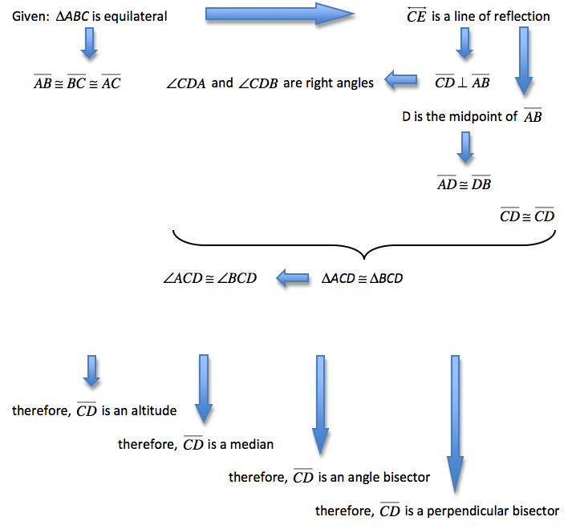
It’s All in Your Head
Use four different colors to identify the statements each of the students—Travis, Tehani, Carlos and Clarita might use to make their case.

Slide 66
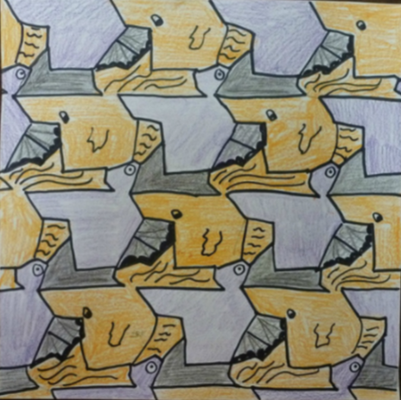
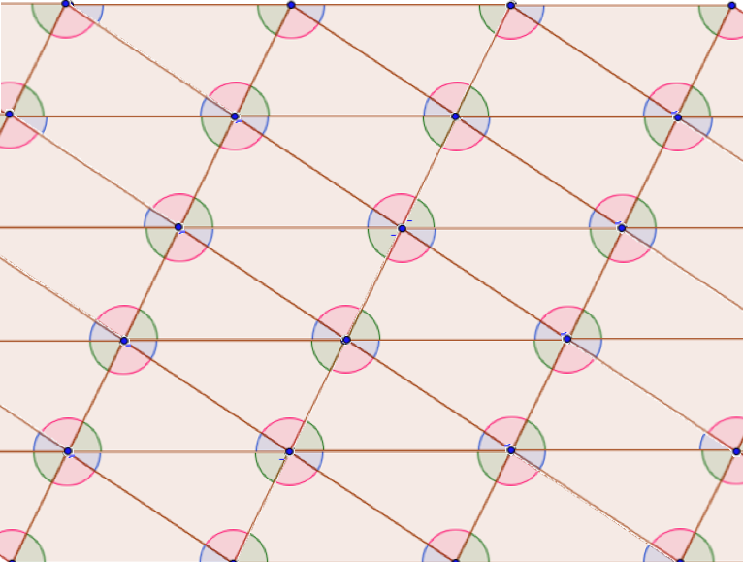
Claims and Conjectures
Using the diagram, make some conjectures about lines, angles and triangles.

Slide 67
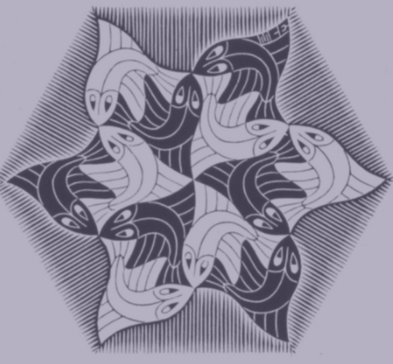
Justification and Proof
Using the diagram, you wrote some conjectures about lines, angles and triangles. Now write proofs to convince yourself that your conjectures are always true.

Slide 68
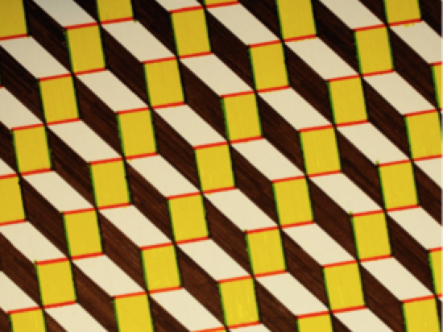
Parallelogram Conjectures and Proof
Explain how you would locate the center of rotation for the following parallelogram. What convinces you that the point you have located is the center of rotation?
If you haven’t already, draw one or both of the diagonals in the above parallelogram. Use this diagram to prove this statement: opposite sides of a parallelogram are congruent
Use this diagram to prove this statement: opposite angles of a parallelogram are congruent
Use this diagram to prove this statement: the diagonals of a parallelogram bisect each other

Slide 69
Taking a Transformations Approach
More than doing transformations
Bring out the underlying structure
Allow intuition to lead
Press on students to substantiate their reasoning

Slide 70
http://bit.ly/MVPpresentations mathematicsvisionproject.org

